Slide 1


<Muhammad Bilal Baig>
<20/02/2025>

Slide 2
Outline
Executive Summary
Introduction
Methodology
Results
Conclusion

Slide 3

Executive Summary
Methodology Overview
Collecting data through APIs and web scraping
Cleaning and preprocessing data
Conducting exploratory data analysis with SQL and visualization tools
Creating interactive visualizations using Folium
Implementing machine learning for predictive analysis
Summary of Results
Key insights from exploratory data analysis
Screenshots demonstrating interactive analytics
Outcomes from predictive modeling

Slide 4
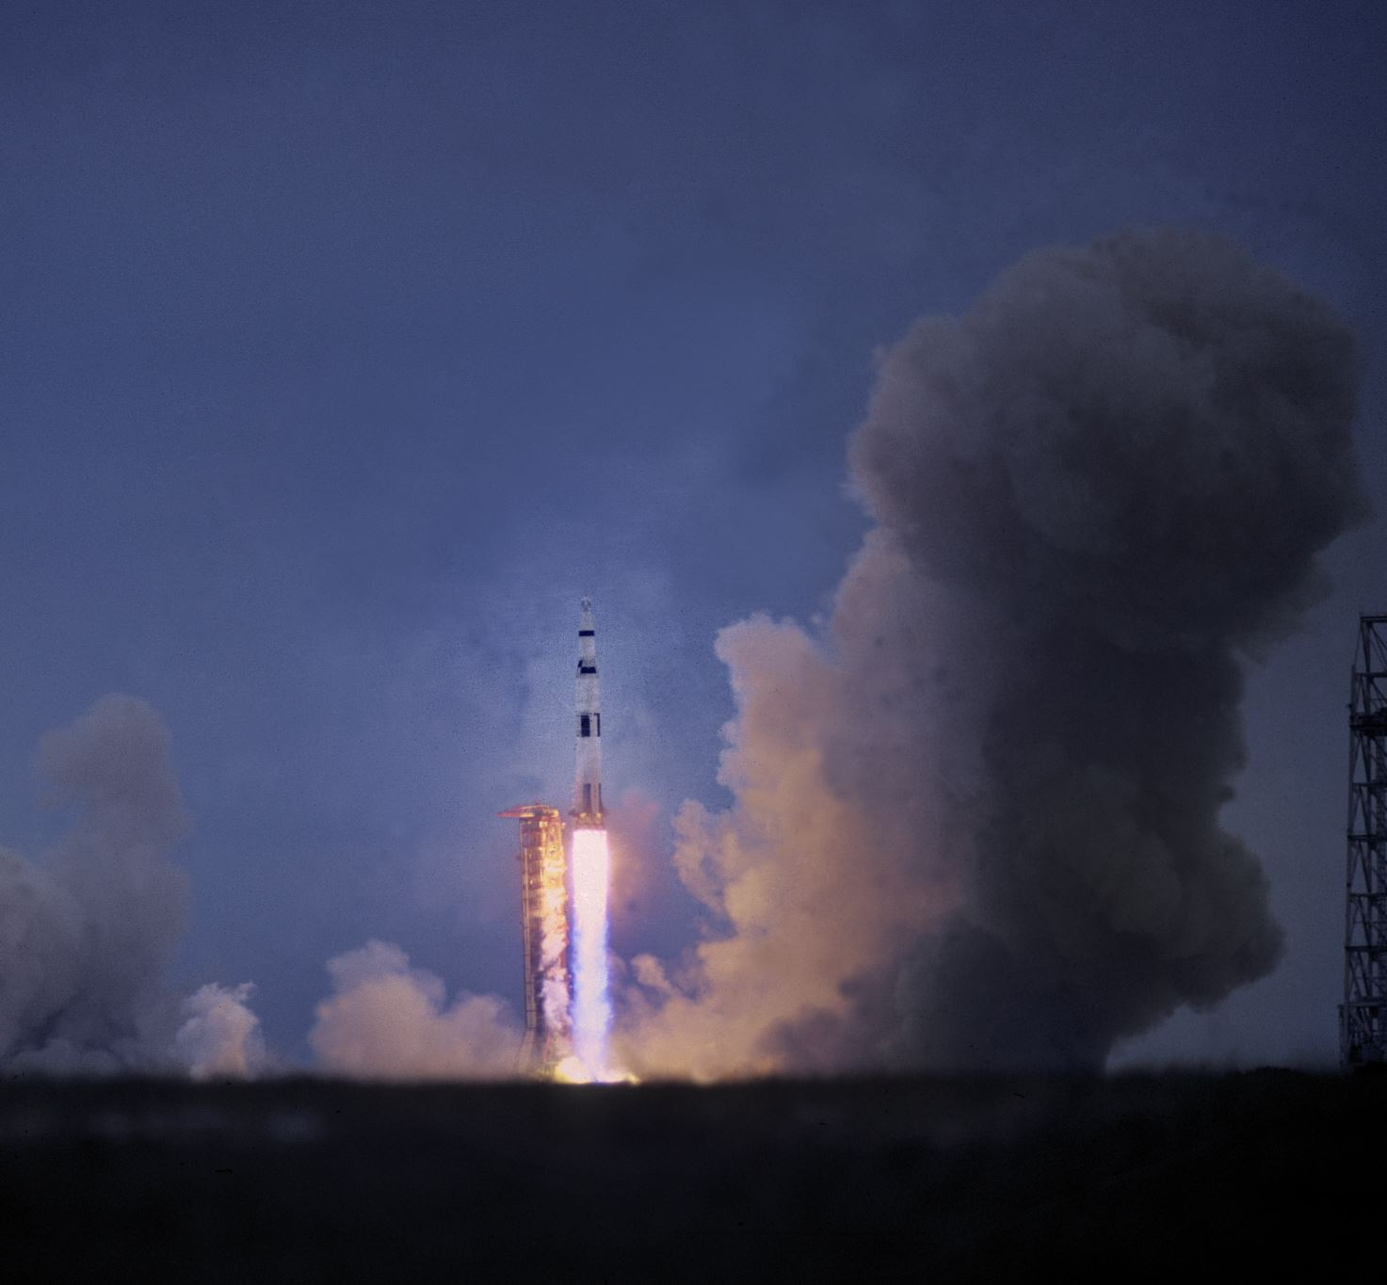
Introduction
Project Background and Context
SpaceX advertises Falcon 9 rocket launches at $62 million per launch, significantly lower than other providers, which can exceed $165 million. The key to these cost savings is the reusability of the first stage. If we can predict whether the first stage will successfully land, we can estimate launch costs more accurately. This information is valuable for competing companies looking to bid against SpaceX. The project's objective is to develop a machine learning pipeline to predict the likelihood of a successful first-stage landing.
Key Problems to Address
Identifying the factors that influence the rocket’s landing success.
Understanding how different features interact to impact the landing outcome.
Determining the necessary operating conditions for a reliable landing program.

Slide 5

Section 1

Slide 6

Methodology
Executive Summary
Data Collection Methodology:
Data was gathered through the SpaceX API and web scraping from Wikipedia.
Data Wrangling:
One-hot encoding was used for categorical features.
Exploratory Data Analysis (EDA):
Data exploration was conducted using visualizations and SQL queries.
Interactive Visual Analytics:
Folium and Plotly Dash were utilized to create interactive data visualizations.
Predictive Analysis:
Classification models were developed for prediction.
Techniques for building, tuning, and evaluating classification models were applied.

Slide 7
Data Collection
Data Collection Methods:
Used a GET request to the SpaceX API to retrieve launch data.
Decoded the API response as JSON with .json(), then converted it into a pandas DataFrame using .json_normalize().
Cleaned the data, checked for missing values, and imputed them where needed.
Conducted web scraping from Wikipedia to gather Falcon 9 launch records using BeautifulSoup.
Extracted and parsed HTML tables, then converted them into a pandas DataFrame for analysis.

Slide 8

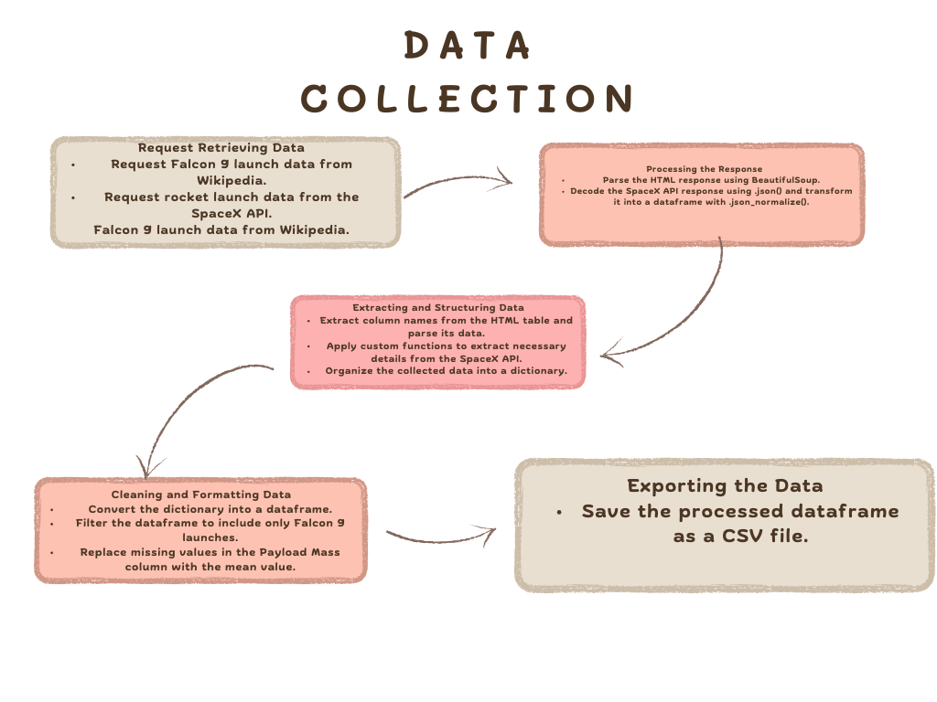
Data Collection – SpaceX API
We retrieved data from the SpaceX API using a GET request, then cleaned, formatted, and performed basic data wrangling on the collected data.
The link to github is:https://github.com/Bilalbaig11/Data-science-capstone-project/blob/main/labs-jupyter-spacex-Data%20wrangling.ipynb
Place your flowchart of SpaceX API calls here

Slide 9
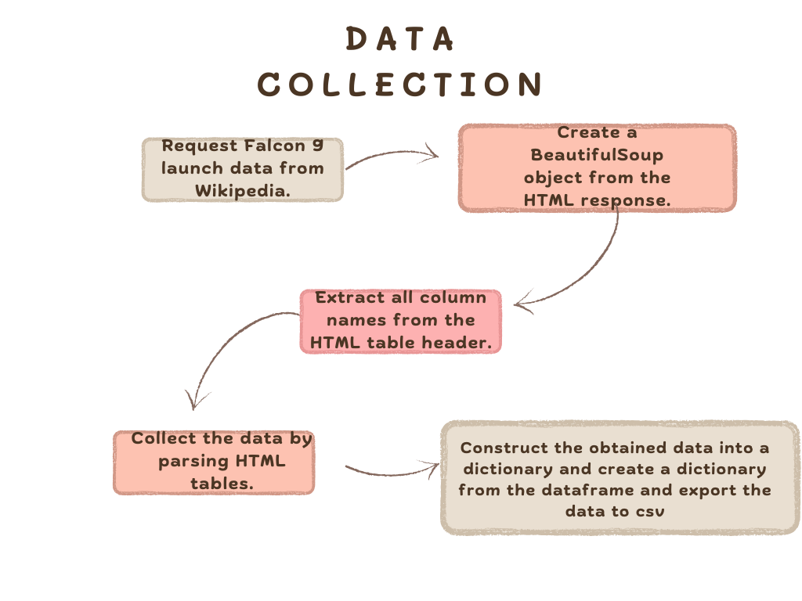
Data Collection - Scraping
We performed web scraping to extract Falcon 9 launch records using BeautifulSoup.The extracted tables were parsed and converted into a pandas DataFrame.
The link to the notebook is: https://github.com/Bilalbaig11/Data-science-capstone-project/blob/main/labs-jupyter-spacex-Data%20wrangling.ipynb
Place your flowchart of web scraping here

Slide 10
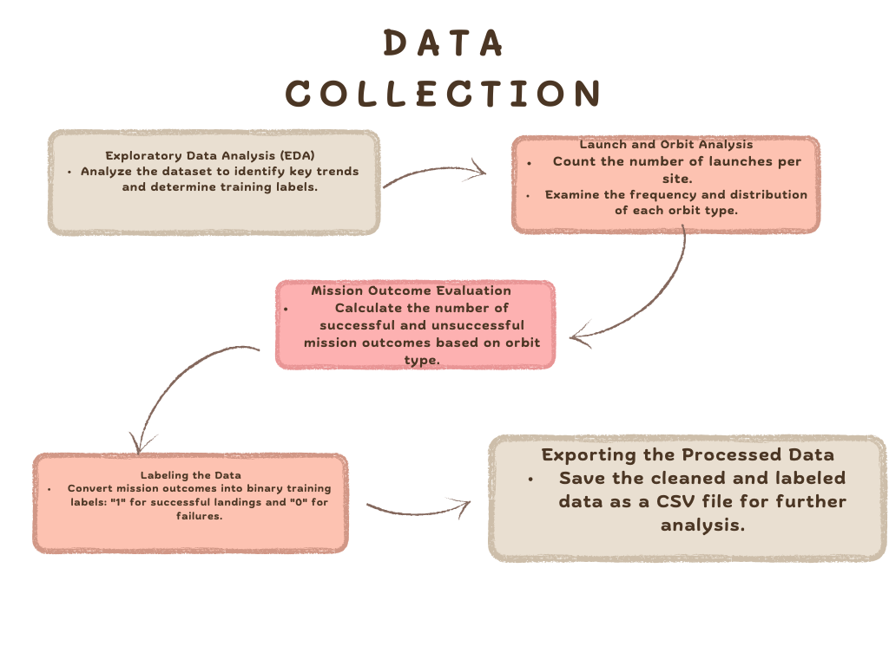
Data Wrangling
In the dataset, there are several situations where the booster did not land successfully. Sometimes, the landing was attempted but failed due to an accident. For instance:
True Ocean indicates a successful landing in a specific area of the ocean, while False Ocean means the landing was unsuccessful in that area.
True RTLS refers to a successful landing on a ground pad, while False RTLS means the landing failed on the ground pad.
True ASDS means the landing was successful on a drone ship, while False ASDS indicates the landing was unsuccessful on the drone ship.
We convert these outcomes into training labels:
1 means the booster successfully landed.
0 means the landing was unsuccessful.
The following tasks are also part of the data wrangling process:
Perform exploratory data analysis (EDA) and determine training labels.
Calculate the number of launches per site.
Calculate the number and occurrences of each orbit.
Calculate the number and occurrences of mission outcomes per orbit type.
Create a landing outcome label from the Outcome column.
Export the final data to CSV.
GitHub URL: https://github.com/Bilalbaig11/Data-science-capstone-project/blob/main/labs-jupyter-spacex-Data%20wrangling.ipynb

Slide 11
EDA with Data Visualization
Charts Plotted:
Various charts were created to analyze different relationships in the dataset, including:
Flight Number vs. Payload Mass
Flight Number vs. Launch Site
Payload Mass vs. Launch Site
Orbit Type vs. Success Rate
Flight Number vs. Orbit Type
Payload Mass vs. Orbit Type
Success Rate Yearly Trend
Chart Interpretations:
Scatter plots visualize the relationships between variables. If a pattern is observed, these relationships can be utilized in a machine learning model.
Bar charts compare discrete categories, helping to illustrate the relationship between different categories and their corresponding values.
Line charts capture trends over time, providing insights into how data evolves in a time series.
Let me know if you need any refinements!
The github link is: https://github.com/Bilalbaig11/Data-science-capstone-project/blob/main/visualization.ipynb

Slide 12
SQL-Based Exploratory Data Analysis on SpaceX Dataset:
The SpaceX dataset was loaded into a PostgreSQL database directly within the Jupyter Notebook.
Exploratory Data Analysis (EDA) was performed using SQL queries to extract insights, including:
Identifying unique launch sites involved in space missions.
Calculating the total payload mass carried by NASA (CRS) booster launches.
Determining the average payload mass for the F9 v1.1 booster version.
Summarizing the total count of successful and failed mission outcomes.
Analyzing failed landings on drone ships, including booster versions and launch site details.
The github link is:https://github.com/Bilalbaig11/Data-science-capstone-project/blob/main/jupyter-labs-eda-sql-coursera_sqllite.ipynb
EDA with SQL

Slide 13
Geospatial Analysis of SpaceX Launch Sites:
Mapped all launch sites using markers, circles, and lines on a Folium map to visualize launch successes and failures.
Classified launch outcomes into two categories:
0 for failure
1 for success
Used color-coded marker clusters to identify launch sites with higher success rates.
Calculated distances between launch sites and nearby features to answer key questions:
Are launch sites located near railways, highways, and coastlines?
Do launch sites maintain a specific distance from cities?
THE github link is :https://github.com/Bilalbaig11/Data-science-capstone-project/blob/main/lab_jupyter_launch_site_location%20(1).ipynb
Build an Interactive Map with Folium

Slide 14
Machine Learning Model Development:
Loaded and preprocessed data using NumPy and Pandas, then split it into training and testing sets.
Built multiple machine learning models and optimized hyperparameters using GridSearchCV.
Used accuracy as the performance metric, improving the model through feature engineering and algorithm tuning.
Identified the best-performing classification model based on evaluation metrics.
THE github link is: https://github.com/Bilalbaig11/Data-science-capstone-project/blob/main/machinelearning.ipynb
Predictive Analysis (Classification)

Slide 15
Exploratory data analysis results
Interactive analytics demo in screenshots
Predictive analysis results
Results

Slide 16

Section 2

Slide 17
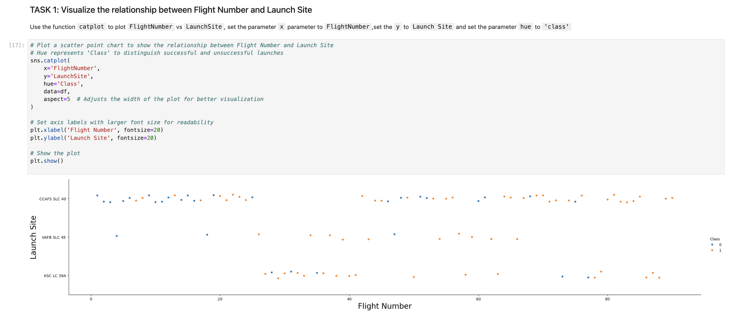
From the plot, we found that the larger the flight amount at a launch site, the greater the success rate at a launch site.
Flight Number vs. Launch Site

Slide 18
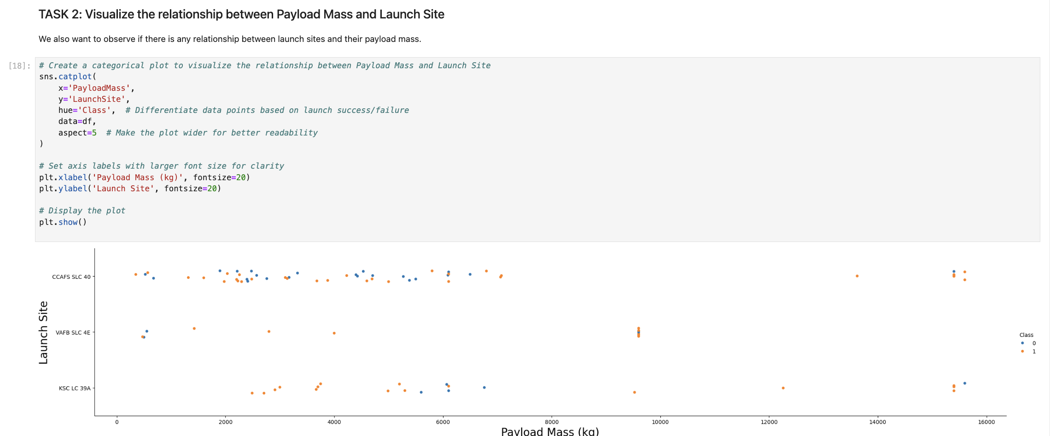
Payload vs. Launch Site

Slide 19
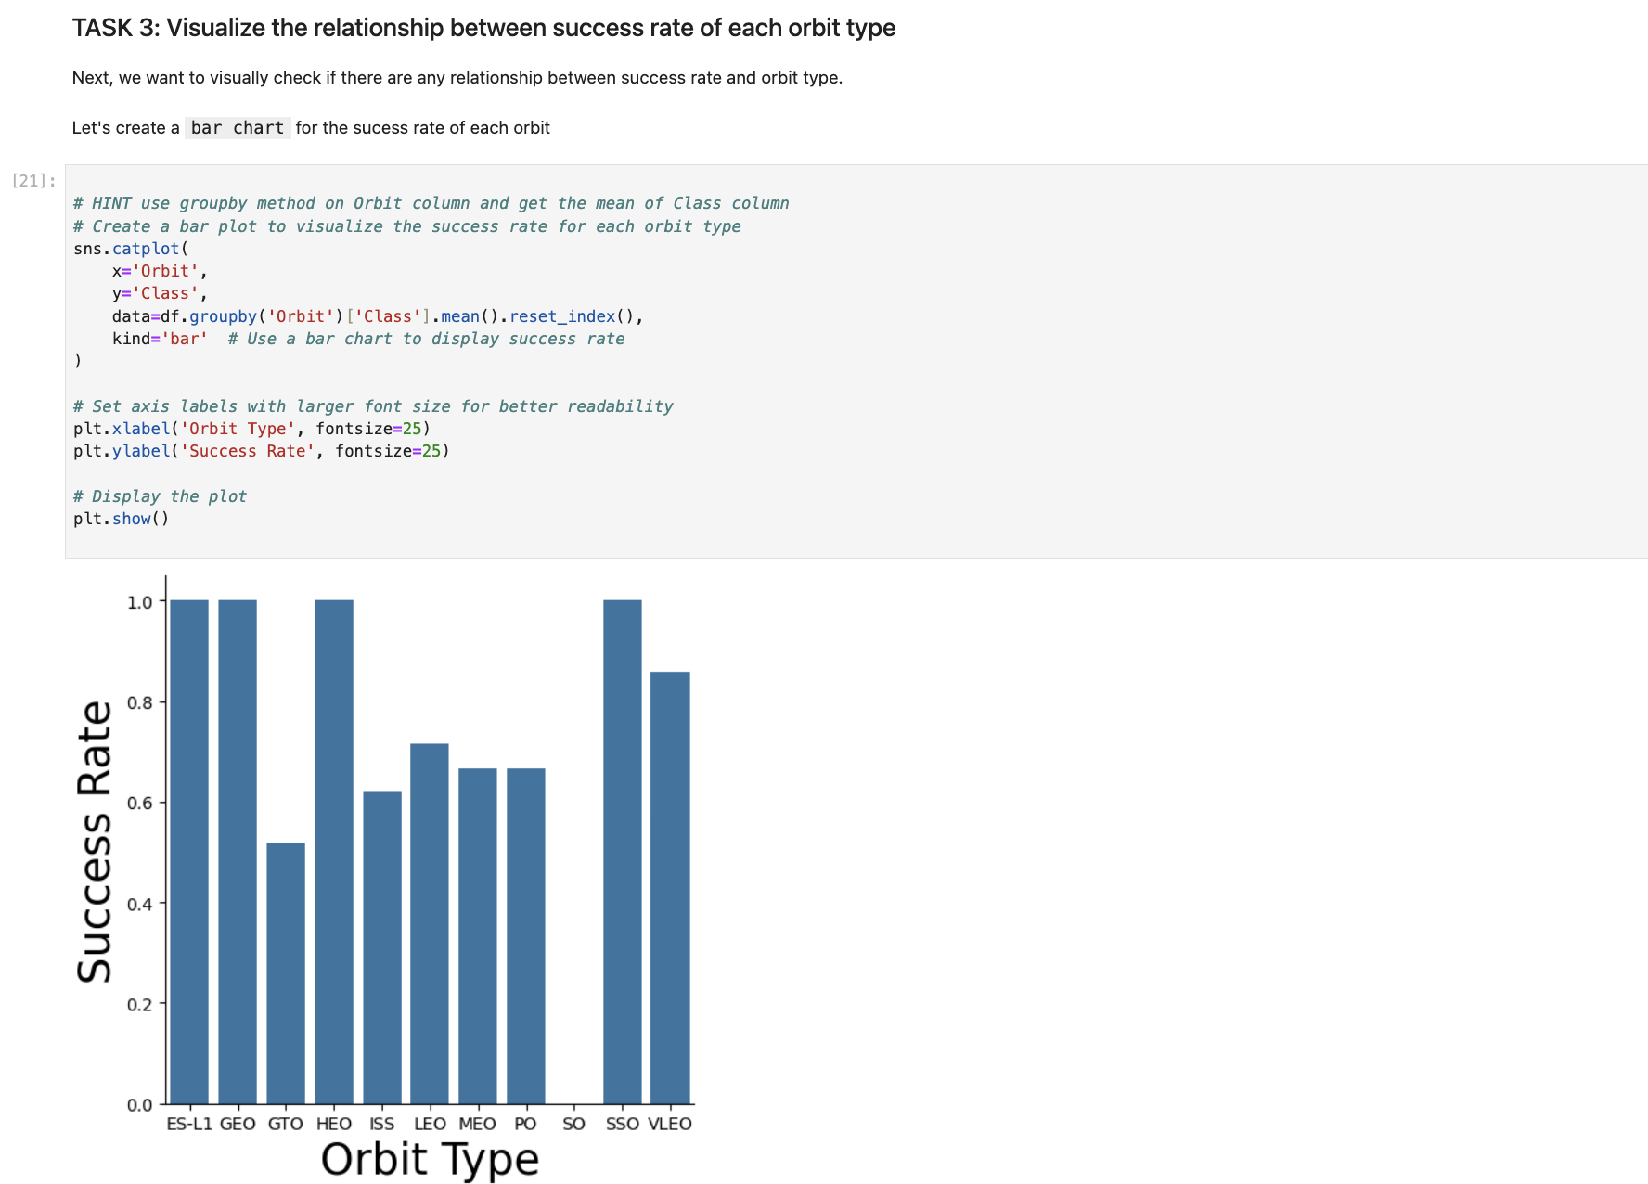
From the plot, we can see that ES-L1, GEO, HEO, SSO, VLEO had the most success rate.
Success Rate vs. Orbit Type

Slide 20
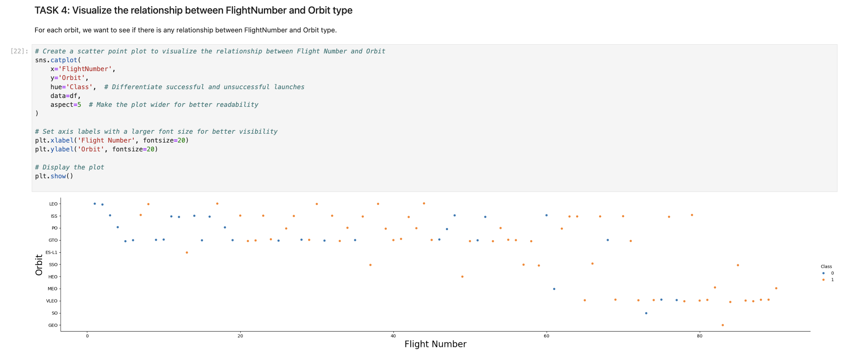
Flight Number vs. Orbit Type
Observation from Flight Number vs. Orbit Type Plot:
In LEO (Low Earth Orbit), success rate increases with the number of flights.
In GTO (Geostationary Transfer Orbit), no clear relationship exists between flight numbers and success.

Slide 21
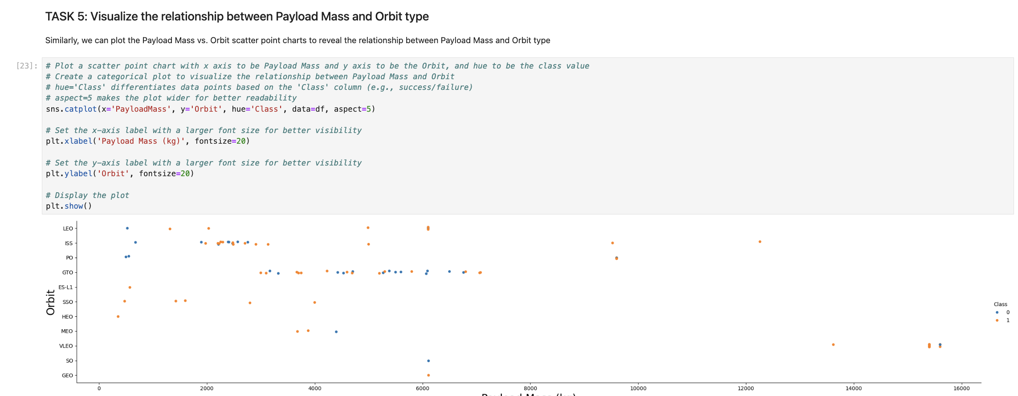
Observation on Heavy Payloads and Successful Landings:
Successful landings are more frequent for PO (Polar Orbit), LEO (Low Earth Orbit), and ISS (International Space Station) orbits when carrying heavy payloads.
Payload vs. Orbit Type

Slide 22
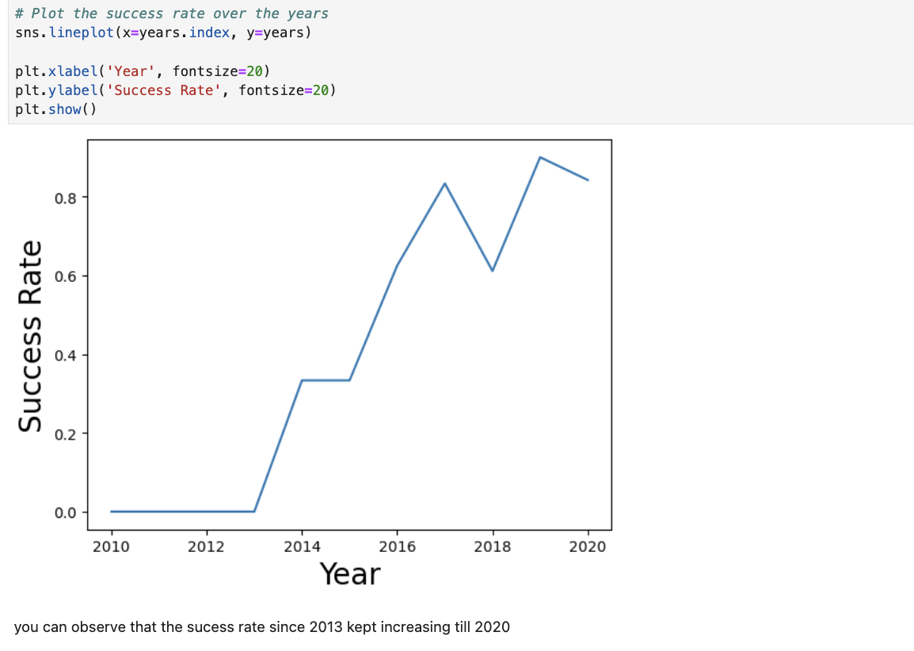
From the plot, we can observe that success rate since 2013 kept on increasing till 2020
Launch Success Yearly Trend

Slide 23
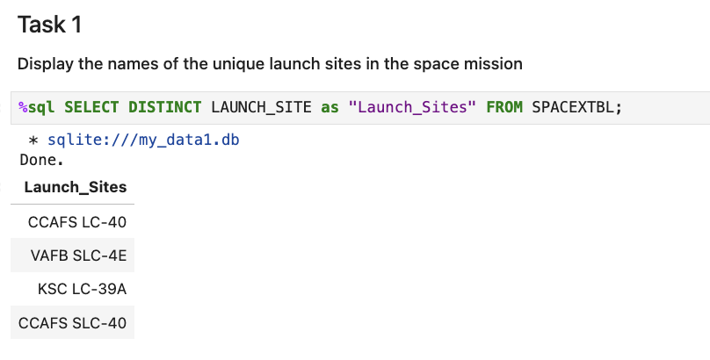
We used the key word DISTINCT to show only unique launch sites from the SpaceX data.
All Launch Site Names

Slide 24
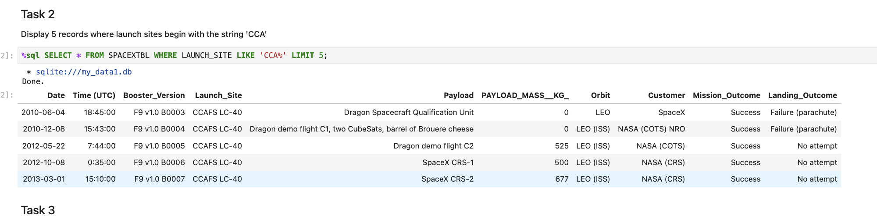
I used the query down below to display 5 records where launch sites begin with `CCA`
Launch Site Names Begin with 'CCA'

Slide 25
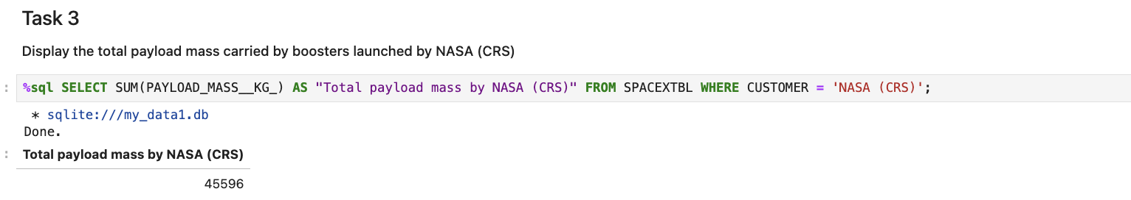
We determined that the total payload carried by NASA boosters is 45,596 using the query below.
Total Payload Mass

Slide 26
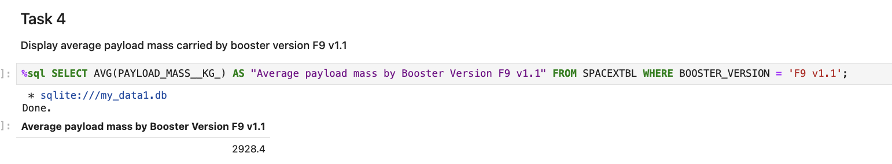
We Determind the average payload mass carried by booster version F9 v1.1 as 2928.4
Average Payload Mass by F9 v1.1

Slide 27
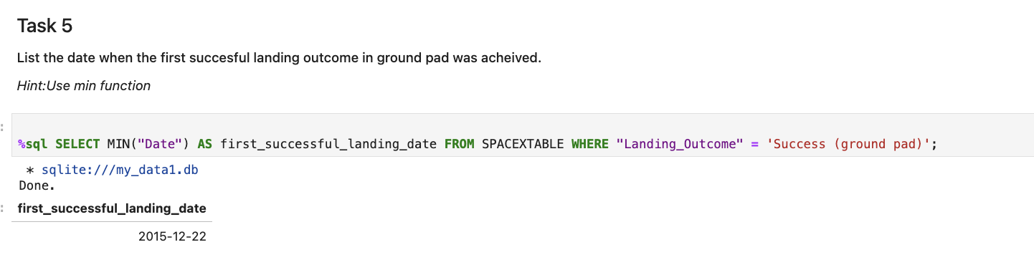
First Successful Ground Landing Date
This statement marks a significant achievement in SpaceX's history: The first successful ground pad landing took place on December 22, 2015. This event likely corresponds to the Falcon 9 Flight 20 mission, which successfully touched down at Landing Zone 1 (LZ-1) in Cape Canaveral

Slide 28
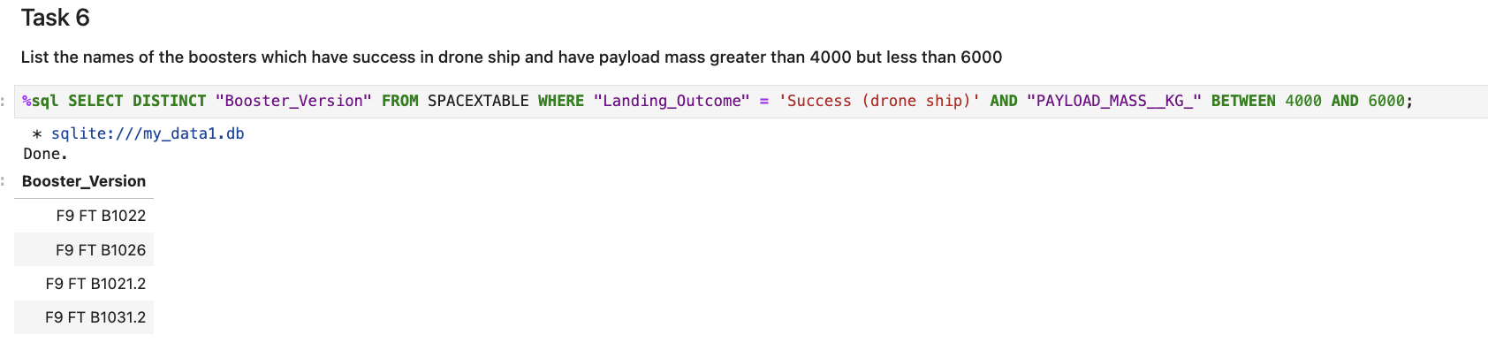
We utilized the WHERE clause to filter boosters that successfully landed on a drone ship and applied the AND condition to identify those with a payload mass between 4,000 and 6,000
Successful Drone Ship Landing with Payload between 4000 and 6000

Slide 29
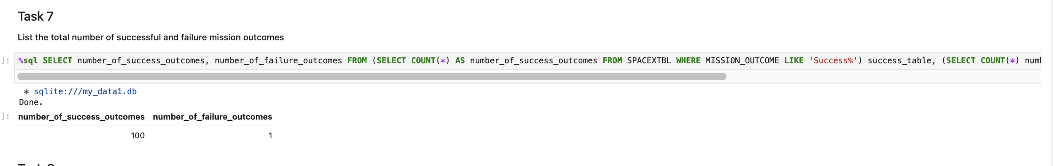
We used the '%' wildcard in the WHERE clause to filter missions based on whether the MissionOutcome was a success or a failure
Total Number of Successful and Failure Mission Outcomes

Slide 30
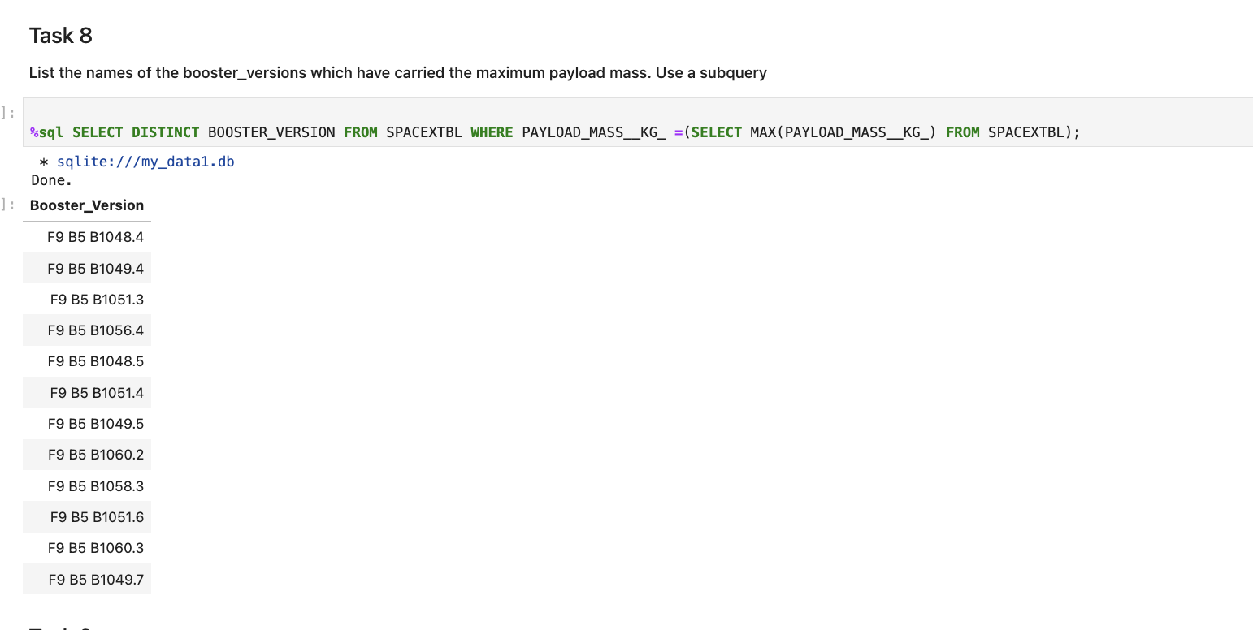
We identified the booster that carried the highest payload by using a subquery in the WHERE clause along with the MAX() function
Boosters Carried Maximum Payload

Slide 31
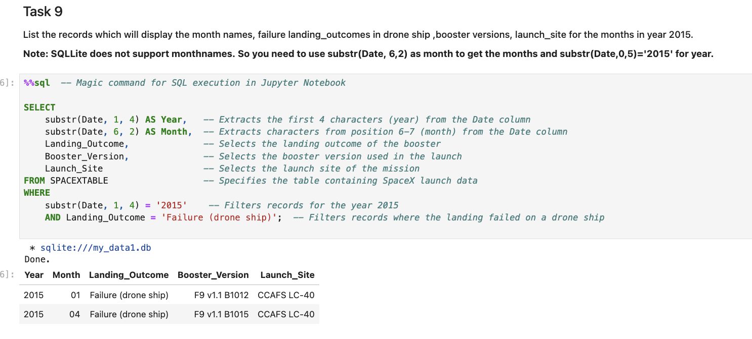
Criteria were applied to filter failed drone ship landings, along with their booster versions and launch site names for the year 2015.
2015 Launch Records

Slide 32
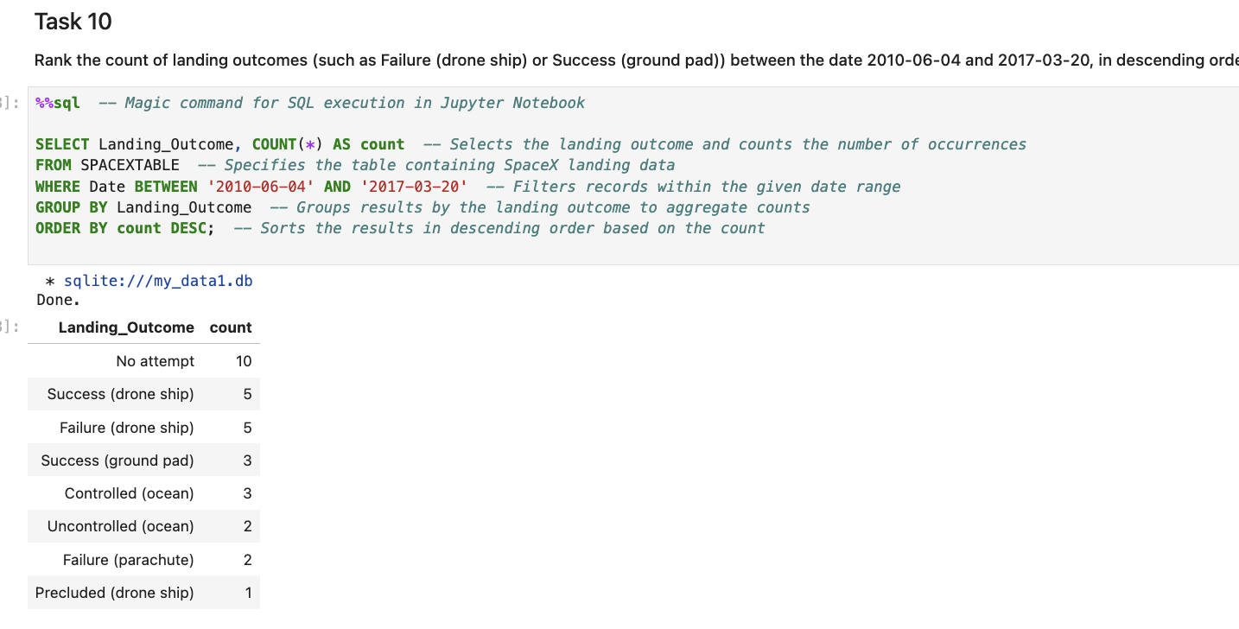
We retrieved landing outcomes along with their counts from the dataset, using the WHERE clause to filter outcomes between June 4, 2010, and March 20, 2010. The GROUP BY clause was applied to categorize landing outcomes, followed by the ORDER BY clause to arrange them in descending order
Rank Landing Outcomes Between 2010-06-04 and 2017-03-20

Slide 33

Section 3

Slide 34
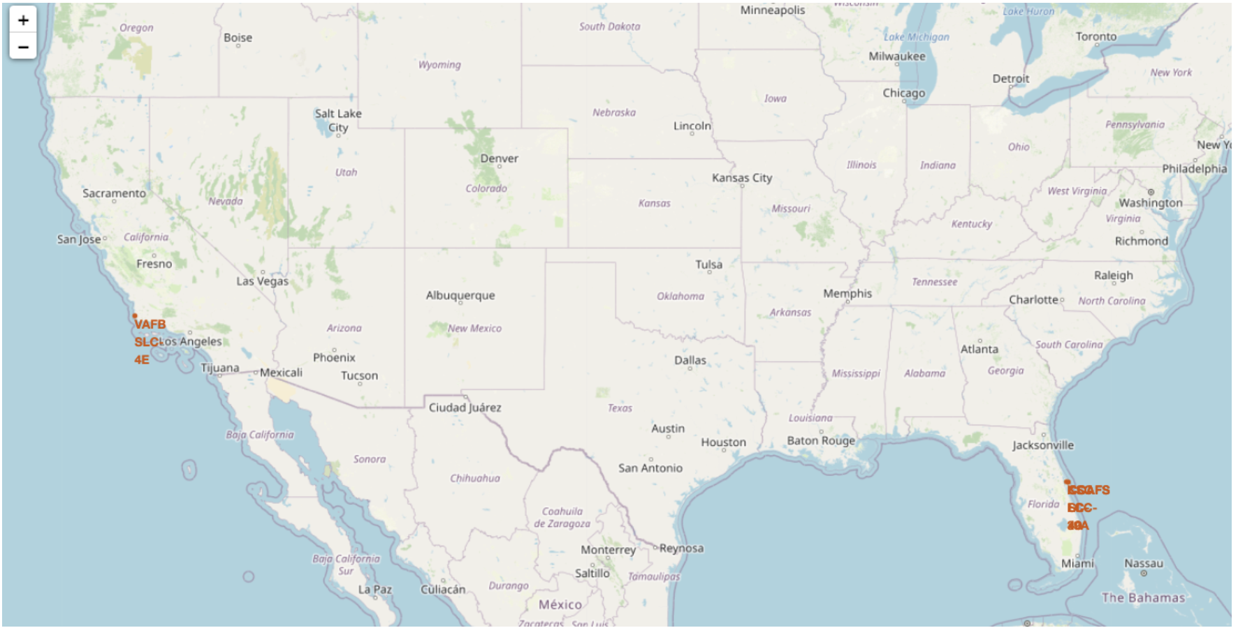
All spaceX launches are on the coastal area of Usa , namely florida and California , more being in florida
All launch sites global map markers

Slide 35
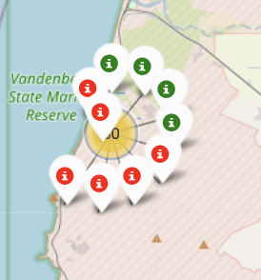
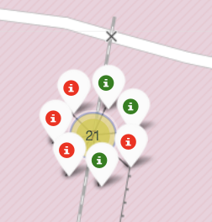
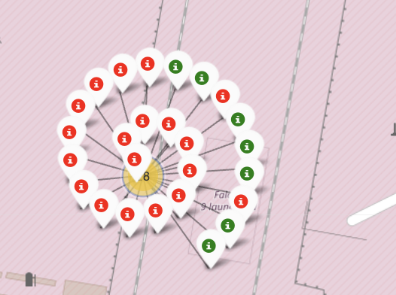
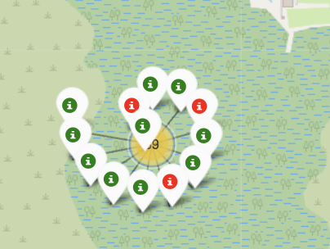
California side
Markers showing launch sites with color labels
Green signs show successful launches and red show all unsuccessful in both states

Slide 36
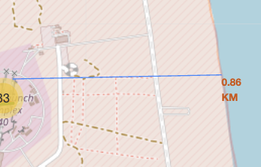
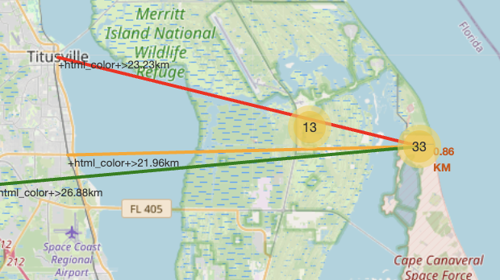
Launch Site distance to landmarks
Both images show different sides . One images that the launch sites were close to the coastal area , in very close promixty with it. The second image shows that the launch sites are all away from the city infrastructure , mainly from highways and train stations.

Slide 37

Section 5

Slide 38
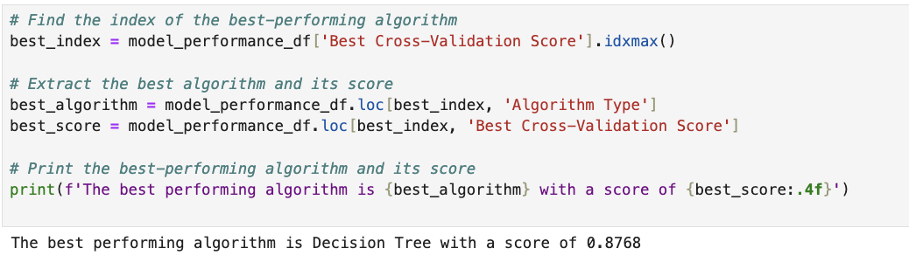
Classification Accuracy
The decision tree classifier is the model with the highest classification accuracy

Slide 39
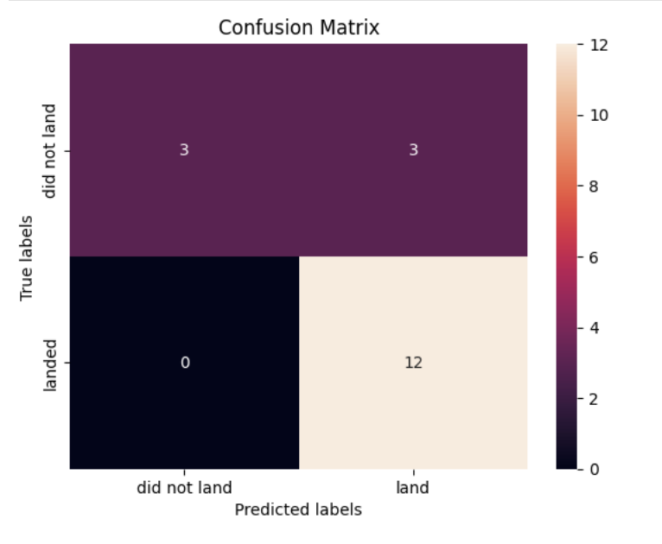
Confusion Matrix
Confusion Matrix Analysis: The Decision Tree classifier effectively differentiates between the classes. However, a key issue is the presence of false positives, where unsuccessful landings are incorrectly classified as successful.

Slide 40
Conclusions
Flight Frequency & Success Rate: Higher flight activity at a launch site correlates with an increased success rate.Time Trend: The launch success rate showed significant improvement from 2013 to 2020.Orbits with High Success Rates: ES-L1, GEO, HEO, SSO, and VLEO had the highest success rates.Top Launch Site: KSC LC-39A recorded the most successful launches among all sites.Best Model: The Decision Tree classifier emerged as the best machine learning algorithm for this task.

Slide 41


